Slide 1
TOPIC No. 15:
Monitoring and care for gastrointestinal patients.

Slide 2
CONTROL QUESTION
Main symptoms of gastroenterological patient.
Appetite changes (types).
Changes in taste.
Impaired swallowing.
Gastric dyspepsia. Heartburn, Belching, Nausea, Vomiting, Epigastric pain.
Character of vomit. Vomit (vomited material ) can contain. Vomiting classification according to appearance mechanism.
Epigastric pain, mechanism, signs.
Intestinal dyspepsia: abdominal distention, diarrhea, constipation, fecal incontinence.
Characteristics of stool.
Diarrhea, causes, mechanism, nursing care.
Constipation, causes of constipation, constipation classification, nursing care.
Standard of nursing Care for gastrointestinal patients.
Nutrition of gastroenterological patient.
Acute abdominal pain, Symptoms, First aid.
Gastrointestinal bleeding, Symptoms, First aid.
Laboratory Methods of stool tests. Coprology, feces analysis on helminthes, stool for occult blood.
General rules for Collection of Stool Specimen.

Slide 3
Learning objectives
On completion of this practical lesson the learner will be able to do the following:
Define key terms used.
Identify the Complaints of patients with gastroenterological pathology.
Give the characteristics the Heartburn, Belching, Nausea, Vomiting, Epigastric pain, Constipation, Diarrhea.
Determine the characteristics of the vomited material, feces.
Diagnose syndrome of acute abdomen, Gastrointestinal bleeding. Provide first aid.
Perform the Stomach lavage with thick gastric probe.
Perform the Stomach lavage with thin gastric probe.
Perform the Inserting of nasogastric probe.

Slide 4
Main symptoms of gastroenterological patients:
Appetite changes
Changes in taste
Dysphagia
Gastric dyspepsia
Intestinal dyspepsia

Slide 5
Appetite changes :
decreased appetite,
lack of appetite,
increased appetite,
aversion to food,
perversion of appetite.

Slide 6
Changes in taste:
reducing taste sensations,
bad taste in the mouth.

Slide 7
Dysphagia
- impaired swallowing.
Difficulty swallowing solid food or liquid food
Сauses:
Organic obstacls
Functional obstacle
Obstacles do not allow the food to move through the esophagus.

Slide 8
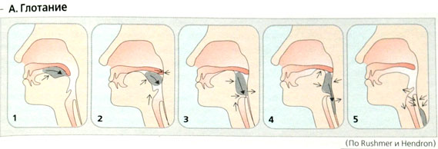

Slide 9
Gastric dyspepsia
Heartburn,
belching,
Nausea,
Vomiting,
Stomach pain

Slide 10
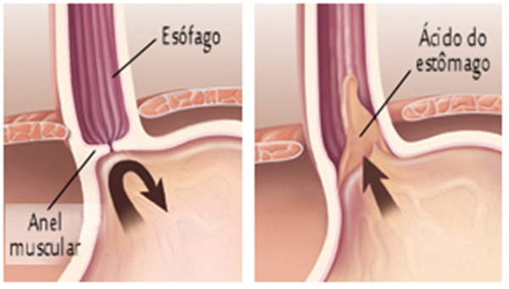
Heartburn
- a burning sensation in the epigastrium or behind the breastbone.

Slide 11
Belching
Belching with air. Reason - aerophagia. Aerophagia – swallowing of excess air.
Sour belching. Occurs at high acidity in the stomach.
Belching with bitterness. Occurs in diseases of the gallbladder.
Belching with the smell of rotten [rɔtn]eggs (hydrogen sulfide).
- sudden sonorous output of air through the mouth, sometimes with small amounts of stomach contents.

Slide 12
Nausea
- unpleasant sensation in the epigastrium.
Vomiting
- antiperistaltic reflex contraction of the muscles of the stomach, esophagus, pharynx, and sometimes bowel.
Vomit can contain:
• eaten food
• Bile
• Rotten content
• Intestinal contents
• Coffee ground vomiting
• Blood

Slide 13
Vomiting classification according to appearance mechanism:
Of gastric origin. The reason is a disease of the stomach. After vomiting, the patient always feels easier.
Of central origin. The reason may be the brain damage (concussion). Relief doesn’t come after vomiting.
Of toxic origin. The reason may be severe intoxication. Relief doesn’t come after vomiting.
Of reflex origin. The reason may be acute surgical pathologythe organs of abdominal

Slide 14
Pain signs of gastric origin:
Location - epigastric area
Often pain is cramping
Pain may spread into the heart, spine.
Seasonality of pain
Connection between pain and food intake (Early and Later pain)
Types of stomach pain depending on food intake:
There are:
Early pain. Pain appears or intensifies after eating.
Later (hungry) pain. Pain comes or increases when a stomach is empty. Patients feel better after food intake.

Slide 15
Intestinal dyspepsia :
abdominal distention
diarrhea
constipation
fecal incontinence

Slide 16
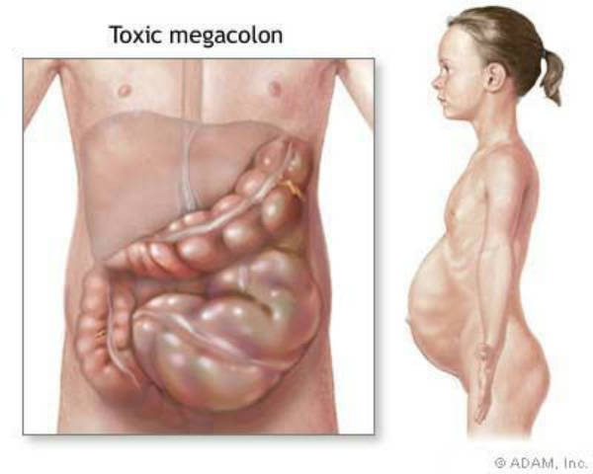
Abdominal distention -
excessive accumulation of gases in the intestines. This symptom is called flatulence.

Slide 17
Diarrhea
– frequent, liquid, watery stools, three or more times a day.
Characteristics of stool:
Frequency of feces.
Colour.
Consistency and form.
Odour

Slide 18
Constipation
– long delay of feces in the intestine (more than 48 hours), sometimes painful passage of hard, dry stool.
Constipation classification depending on the mechanism:
Spastic constipation. Occurs due to spasm of the muscles of the intestine. Spasm promotes retention of passage of feces.
Atonic constipation. Occurs due to the lack of physical activity. As a result, intestinal motility is reduced. Feces moves slowly through the intestines. Much water is absorbed back into the blood. Feces becomes dry.
Alimentary constipation. Arises because of the lack of fiber in the diet.
Reflex constipation. Occurs in case of artificial delay of defecation.

Slide 19
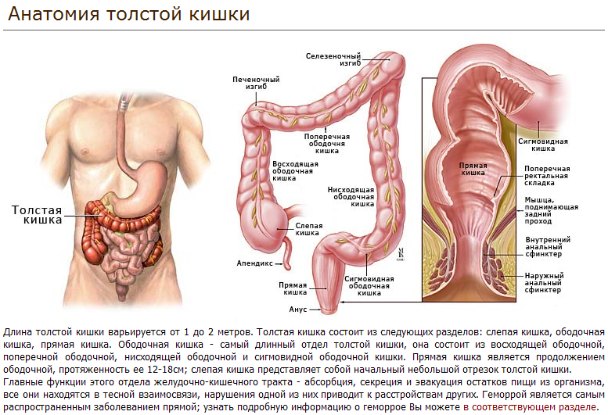

Slide 20
Standard of nursing Care:
Physical Examination
Diagnostic Studies: preparation for instrumental studies.
Diagnostic Studies: preparation for laboratory studies (coprology, feces analysis on helminthes, fecal occult blood).
Nutrition.
Procedures of the digestive tract (probe procedures, enemas).
Pharmacological therapy (Control of the regular intake of medicines).
Advice to patient (Education).
First Aid (predoctor care) & Emergencies (pain syndrome, gastrointestinal bleeding.)

Slide 21
Nursing care in Constipation
Health Teaching
Adequate Intake of Diet
3. Adequate Intake of Roughage in Duet
4. Establishing a Habit Pattern
5. Relaxation
6. Enema
7. Privacy
8. Posture
9. Exercise
10. Adequate Amount of Fluid Intake

Slide 22
Nursing Care in Diarrhoea
1. Replacement of fluid and electrolytes
2. Small frequent feedings
3. Make arrangement for the use of bedpan or commode which is placed in a convenient and accessible place.
4. Care of the skin
5. Adequate rest
6. Psychological support
7. Medications

Slide 23
Acute abdominal syndrome
Acute abdominal syndrome: observed in acute abdominal disease. The symptoms start gradually and reach a peak after a few hours.
Reasons:
Acute appendicitis
Acute peptic ulcer and its complications
Acute cholecystitis
Acute pancreatitis
Acute intestinal ischemia (see section below)
Acute diverticulitis
Ectopic pregnancy with tubal rupture
Acute ureteric colic
Ovarian torsion and etc.
As a result, acute peritonitis develops.

Slide 24
Acute abdominal syndrome:
Complaints:
Severe abdominal pain
Nausea and vomiting
The delay of a chair and gases
Objective data:
Clear consciousness,
Forced position - fetal position
Pale skin
Tongue dry with yellow plaque
«Hard» and painful abdomen at a palpation
Temperature increase
First aid:
Call for a doctor
Help to take a forced position. Side lateral position, legs bent at the knees, pull up to the abdomen, lead hands to stomach.
You Must Not feed, water, warm the patient, give painkillers.

Slide 25
Gastrointestinal bleeding. Local symptoms:
Bleeding from the stomach - Vomit looks like "coffee grounds“. The gastric acid digests the hemoglobin to brown color.
Fresh blood in the vomit (if gastric big bleeding)
Bleeding from small intestine - black, tarry stools (melena).
Bleeding from the colon - blood in the stool, blood is mixed with feces.
Bleeding from the rectum - fresh blood in the stool, blood on surface of stool.
Symptoms associated with the blood loss include. General symptoms (associated with anemia):
Fatigue
Weakness
Pale skin
Tachypnea
Tachycardia
Low blood pressure

Slide 26
Gastrointestinal bleeding. First aid:
Call for a doctor
The patient should be placed in bed (middle Fowler‘s position), head to one side
Ice bag is applied to the epigastrium.
Collect the blood in dry clean glass to check its amount.
Do not drink, do not eat, do not take oral medication.

Slide 27
Classic laboratory Methods of feces research:
coprology,
feces analysis on helminthes,
stool for occult blood

Slide 28
General rules for Collection of Stool Specimen:
Do not use a laxative before collecting specimen.
Only fresh feces is collected for research.
Empty the bladder before collecting of feces.
Collect feces in a bedpan.
Central portion of feces is placed in a disposable container with a special spoon.
Put the required amount of feces in the container.
While using a container, put on gloves.

